Slide 1
Financial Analytics
Saniya Nilesh Deshpande

Slide 2
Introduction
The dataset under analysis consists of financial information for various companies, including market capitalization ('Mar Cap - Crore') and quarterly sales ('Sales Qtr - Crore’).
Descriptive statistics reveal a diverse range of values, while visualizations, such as histograms and bar charts, offer insights into the distribution of financial metrics.
The analysis aims to provide a concise overview of key financial indicators and trends within the dataset.

Slide 3
Details of data
Size:
The dataset comprises 488 rows and 5 columns.
Columns:
'S.No.': Serial number or index.
'Name': Company names.
'Mar Cap - Crore': Market capitalization in Crores.
'Sales Qtr - Crore': Quarterly sales in Crores.
'Unnamed: 4': An unnamed column with a large number of missing values.
Missing Values:
'Mar Cap - Crore' has 9 missing values.
'Sales Qtr - Crore' has 123 missing values.
'Unnamed: 4' has 394 missing values.
4.Descriptive Statistics:
'Mar Cap - Crore':
Mean: 28043.86
Standard Deviation: 59464.62
Minimum: 3017.07
Maximum: 583436.72
'Sales Qtr - Crore':
Mean: 4395.98
Standard Deviation: 11092.21
Minimum: 47.24
Maximum: 110666.93

Slide 4
Main kpi
1. Market Capitalization ('Mar Cap - Crore'):
- Represents the total market value of a company's outstanding shares of stock.
- Key indicator of a company's size and financial performance in the market.
- Calculated in Crores (Indian Rupees).
2. Quarterly Sales ('Sales Qtr - Crore'):
- Measures the total sales revenue generated by a company in a quarter.
- Reflects the company's ability to generate revenue from its core business activities.
- Calculated in Crores (Indian Rupees).
These KPIs provide essential insights into a company's financial health, market value, and performance. Market capitalization indicates the overall market perception of the company's value, while quarterly sales reflect its revenue generation during a specific period. Analyzing these KPIs helps assess a company's market position, growth potential, and financial stability.

Slide 5
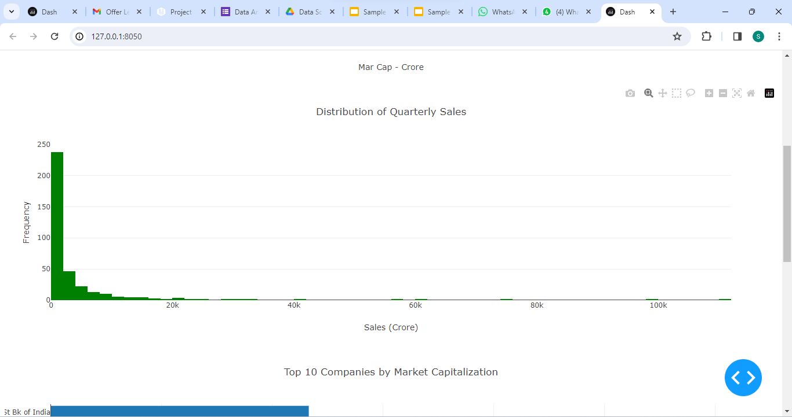
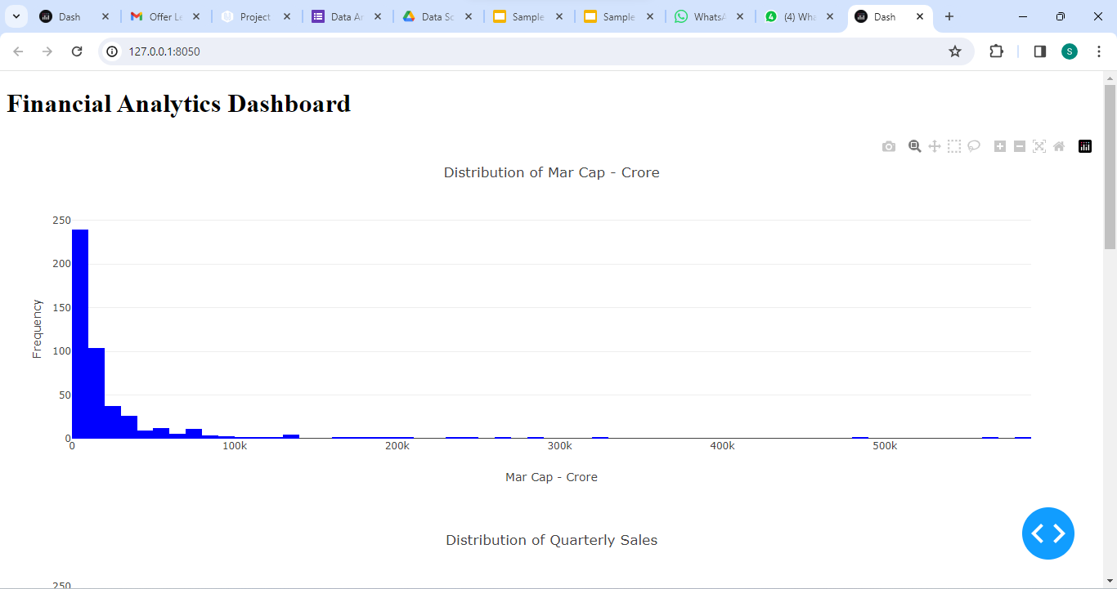
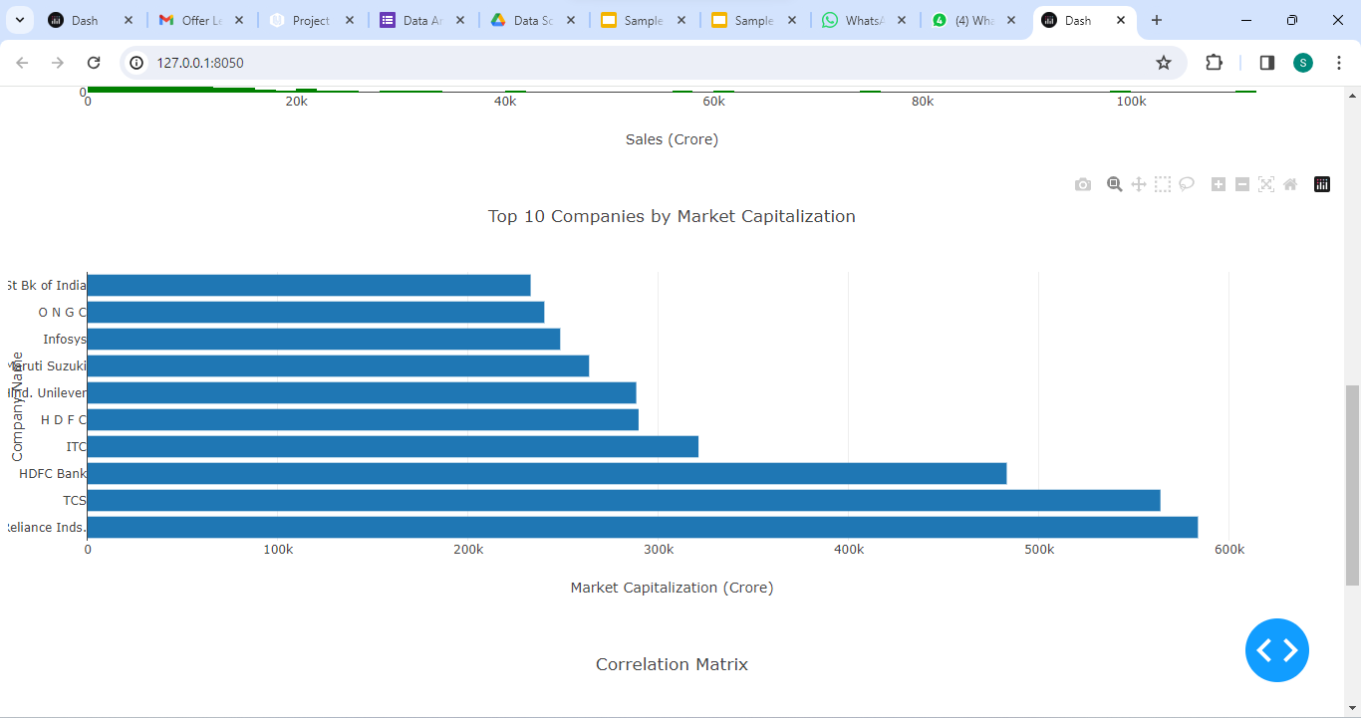
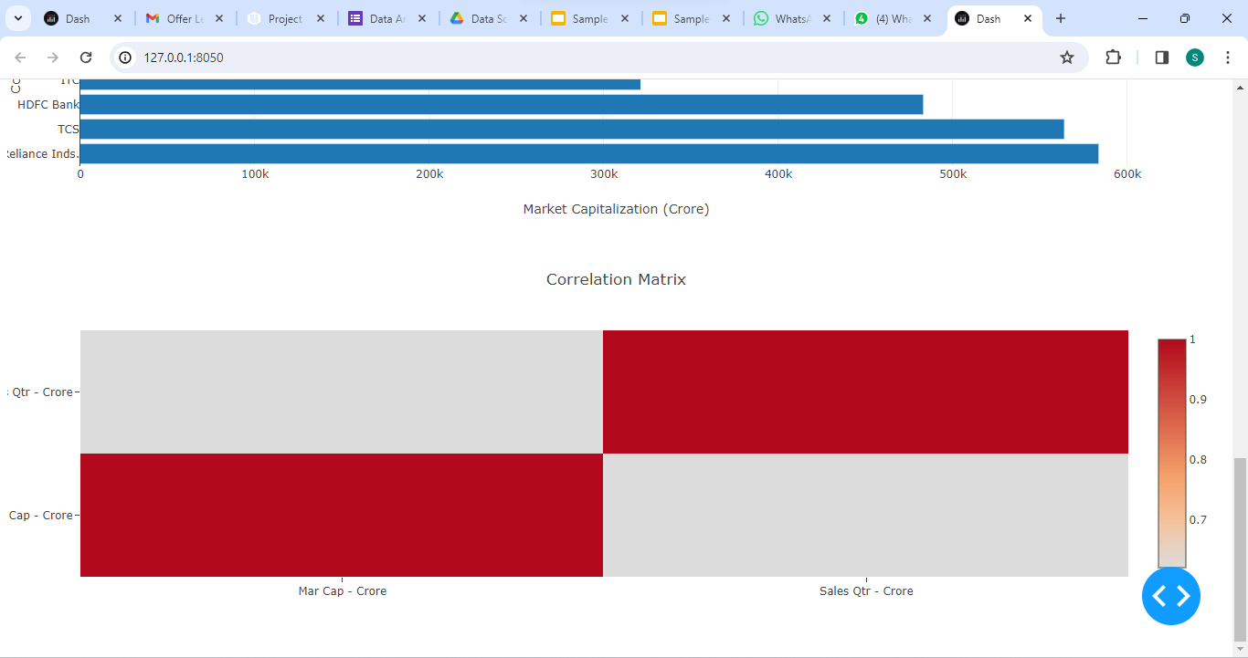
My Design

Slide 6
THANK YOU

